Slide 1
NuvaRing - kada i zašto?
Vilma Kovač MD, PhD
University Clinical Centre Maribor, Slovenia
Clinic for Gynaecology and Perinatology
Department of Reproductive Medicine and Gynaecologyc Endocrinology

Slide 2
Hormonska kontracepcija danas
Posljednih nekoliko godina postignut je značajni napredak na
področju hormonske kontracepcije!
Ključni ciljevi:
    visoka efikasnost
    podnošljivost
    dobra kontrola ciklusa
    prikladnost (compliance)
Kontracepcija je prilagođena potrebama žena in njihovom načinu
života!

Slide 3
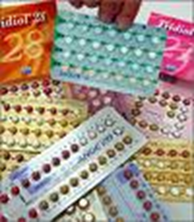
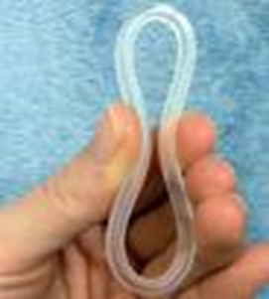
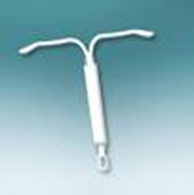
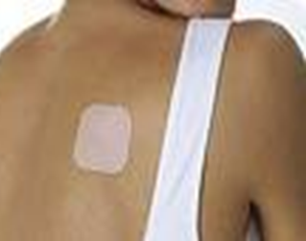

Kontracepcija danas
Žene žele...
Širi izbor
U harmoniji s njihovim
tijelom
Diskretna, udobna
Jednostavna za upotrebu
Sigurna
Malo nuspojava

Slide 4




Mnogi faktori utječu na odnos, prihvačanje i izbor kontracepcije!
Zbog visokog obrazovanja i pristupa informacijama, se položaj žena u društvu mijenja.
Žene su svjesne svoje individualnosti, ciljeva i potreba.
Žele biti ravnopravni partneri u izboru metode kontracepcije.

Slide 5


U reproduktivnom razdoblju se želja za određenom kontracepcijskom metodom može menjati, kako se mijenja i životna situacija!

Slide 6
Hormonal contraceptive use in Europe*
*Countries include France, Germany, Italy, Spain, the United Kingdom, Russia, Scandinavia, Austria, Czech Republic and the Baltic States; OC=oral contraceptive; IUS=intrauterine system
Cibula D. Women's contraceptive practices and sexual behaviour in Europe.
Eur J Contracept Reprod Health Care 2008;13(4):362-375
Notes:
This survey assessed current and past use, awareness and satisfaction with available contraceptive methods. It also assessed sexual and reproductive behavior of women in 14 European countries (Spain, Italy, UK, France, Germany, Sweden, Denmark, Norway, Czech Republic, Austria, Lavonia, Latvia, Lithuania and Russian Federation). A total of 11,490 women aged 15-49 years participated, completing either web-based or face-to-face interviews in June 2006.
There was heterogeneity in the pattern of overall hormonal contraceptive use across Europe with the highest use rates in France and Austria (57.4 and 57.0%, respectively) and the lowest rates in the Baltic States, Spain and Russia (16.6–22.6%).

Slide 7
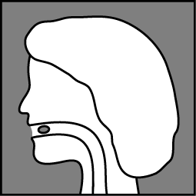
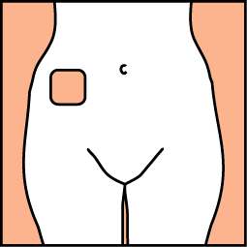
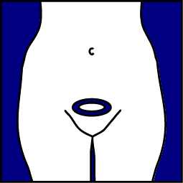
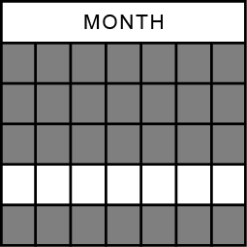
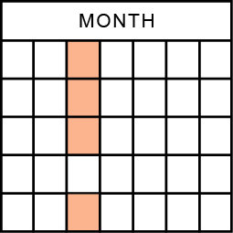
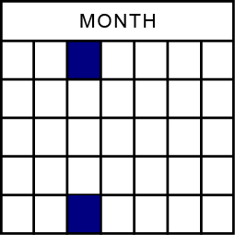
Kombinirana hormonska kontracepcija
Oral,
daily
Skin Patch,
Weekly
Vaginal ring,
Monthly
Notes:
7
References:
Potts RO, Lobo RA. Transdermal drug delivery: clinical considerations for the obstetrician-gynecologist. Obstet Gynecol. 2005;105:953-961.
Another alternative is The transdermal route, which offers increased compliance because treatment is administered weekly rather than daily. The transdermal route is readily bioavailable, with little or no first pass hepatic metabolism and little hapatic metabolism through the skin.

Slide 8
Neplanirana trudnoča
Među ženama sa neplaniranom trudnoćom, rođenima u Danskoj, 45% jih je uzimalo kontracepciju!¹
Muđu Francuskinjama, 65% neplaniranih trudnoća se desilo uz upotrebu kontracepcje²
  21% od tih žena koristilo je oralne kontraceptive
Razlozi za neuspjeh oralnih kontraceptiva u žena sa ^{neplaniranom trudnoćom} 2
 | Percent of women (n=176)
Took tablets late/forgot to take tablets | 60.3
Illness, medication | 10.6
Vomiting | 7.7
No explanation, do not know | 21.4
¹Rasch V, et al. Hum Reprod 2007;22:1320-1326; ²Bajos N, et al. Hum Reprod 2003;18(5):994-999
Notes:
Rasch et al conducted hospital-based questionnaire interviews with 1328 women aged 15–39 years in Denmark. This was a case-control design; the case group comprised women who requested abortion before the end of the 12th gestational week and the control group comprised pregnant women who came for antenatal care during the 12th–20th gestational weeks. Data were obtained by a self-administered questionnaire focusing on socioeconomic characteristics, contraceptive knowledge, experience and attitudes, and ethnic background.
The Bajos study data are from the first stage of a prospective cohort study (Cohort Contraception Study) of French women age 18–44 years. Data were collected by telephone interview between September 2000 and January 2001. The study population consisted of 2863 women, of whom 1034 had had an abortion or unintended pregnancy in the previous 5 years.

Slide 9

Kontracepcijski vaginalni prsten
NuvaRing je novi oblik kombinirane hormonske kontracepcije!
Bazira na kontinuiranom 21 dnevnom oslobađanju:
  Ethinyl estradiola — 15 µg /d
  Etonogestrela — 120 µg /d
  (aktivni metabolit desogestrela)
Za NuvaRing vrijede iste kontraindikacije kao i za KOK!
Notes:
9
Vaginal Contraceptive Ring: Introduction
NuvaRing is a novel contraceptive method recently approved by the FDA for use in the United States. NuvaRing is inserted into the vagina and releases 15 µg of ethinyl estradiol and 120 µg of etonogestrel, the active metabolite of the progestin desogestrel, both of which are commonly found in combination oral contraceptives. A viable vaginal ring contraceptive is the product of years of research begun in the late 1970s.
References:
Timmer CJ, Mulders TM. Pharmacokinetics of etonogestrel and ethinylestradiol released from a combined contraceptive vaginal ring. Clin Pharmacokinet 2000; 39 (3):233-42.
Harwood B, Mishell DR, Jr. Contraceptive vaginal rings. Semin Reprod Med 2001; 19 (4):381-90.
Ballagh SA. Vaginal ring hormone delivery systems in contraception and menopause. Clin Obstet Gynecol 2001; 44 (1):106-13.

Slide 10
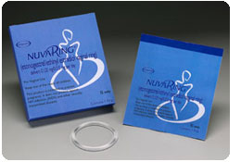
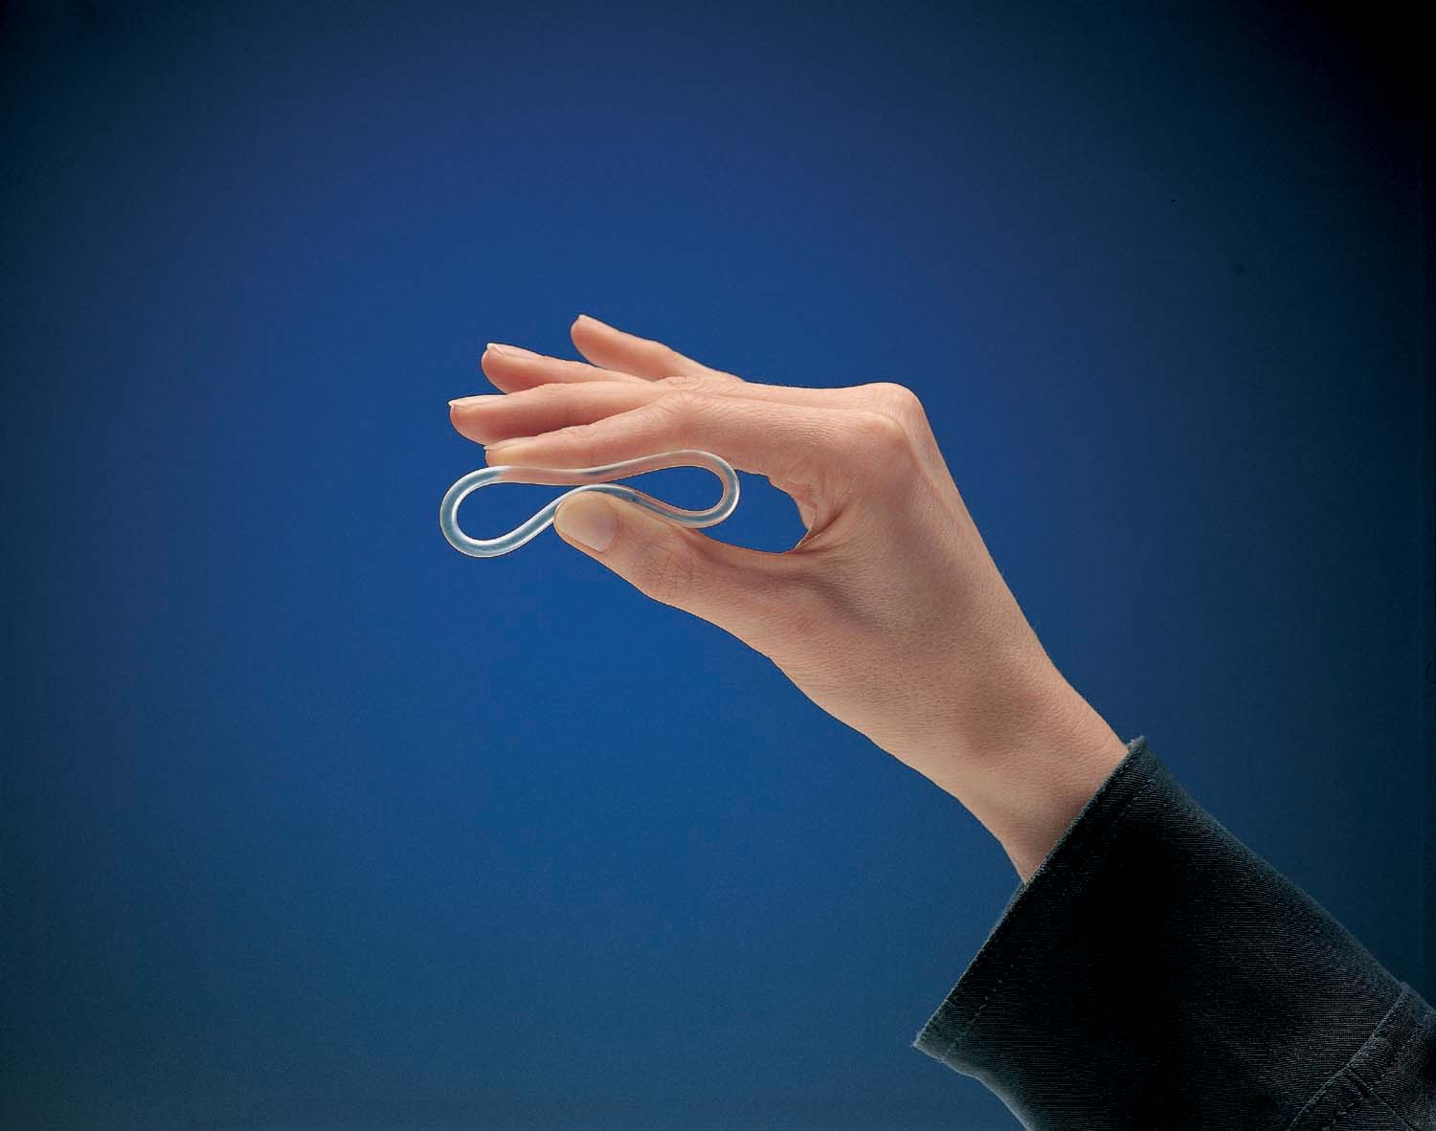
NuvaRing

Slide 11
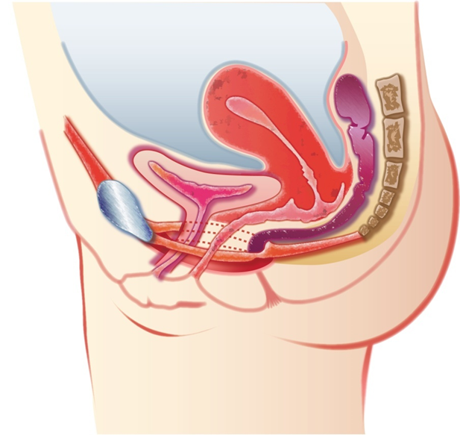
Prednosti vaginalne administracije
Siguran i diskretan anatomski položaj ^{1,2}
Neninvazivan način aplikacije, jednostavno stavljanje i vađenje prstena ^{3–5}
Stabilna absorpcija/dobra farmakokinetika ^{3,6}
Bezbolna /diskretna za žene^{1,7}
ª
1. Alexander NJ et al. Fertil Steril. 2004;82(1):1–12; 2. Funt MI et al. Southern Med J. 1978;71(12):1534–1552; 3. Hussain A et al. J Control Release. 2005;103:301–313; 4. Baloglu E et al. J Pharm Pharm Sci. 2009;12(3):312–336; 5. Roumen FJME et al. Hum Reprod. 1996;11(11):
2443–2448; 6. Darney PD. In: Kronenberg HM et al, eds. Williams Textbook of Endocrinology. 11th ed. Saunders Elsevier; 2008:615–644;
7. Novák A et al. Contraception. 2003;67:187–194; 8. Veres S et al. Obstet Gynecol. 2004;104(3):555–563.
Notes:
Vaginal delivery of contraceptive hormones has the potential to provide several benefits:
• Secure and discreet anatomical placement^{1,2}
• Noninvasive route (unlikely to result in injury) compatible with the local tissue
environment^{3–5}
• Supportive of steady absorption and overall favorable pharmacokinetics of
absorbed hormones^{3,6}
• Painless and not usually very perceptible to the user and others, although some partners may feel the ring in the vagina during intercourse^{1,7}
• Compatible with normal body functioning, eg, no adverse effect on normal
vaginal flora^{1,5,8}
Alexander NJ et al. Fertil Steril. 2004;82(1):1–12.
Funt MI et al. Southern Med J. 1978;71(12):1534–1552.
Hussain A et al. J Control Release. 2005;103:301–313.
Baloglu E et al. J Pharm Pharm Sci. 2009;12(3):312–336.
Roumen FJME et al. Hum Reprod. 1996;11(11):2443–2448.
Darney PD. In: Kronenberg HM et al, eds. Williams Textbook of Endocrinology. 11th ed. Saunders Elsevier;
2008:615–644.
Novák A et al. Contraception. 2003;67:187–194.
Veres S et al. Obstet Gynecol. 2004;104(3):555–563.

Slide 12
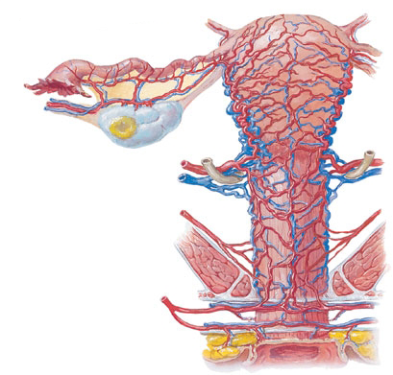
Bogata vaskularna mreža vagine omogučuje dobru absorbciju hormona u vensku cirkulaciju
Hormoni absorbirani kroz
vaginu ulaze u krvotok direktno ^{1–4}
  Izbjegava se metabolizam prvog prolaza kroz jetru
  Omogučuje administraciju niskih doza
  Izbjegava se fluktuacija u serumskoj razini hormona i umanjuje se rizik nuspojava (neredovito krvarenje, mučnina)
1. Hussain A et al. J Control Release. 2005;103:301–313; 2. Corbo DC et al. J Pharm Sci. 1990;79(3):202–206; 3. Alexander NJ et al. Fertil Steril. 2004;82(1):1–12; 4. Darney PD. In: Kronenberg HM et al, eds. Williams Textbook of Endocrinology. 11th ed. Saunders Elsevier; 2008:615–644.
Notes:
The vagina is particularly well suited for absorption of exogenously applied hormones into the venous circulation and favorable pharmacokinetics due to the rich vascular network that surrounds this organ.¹
In contrast to oral administration of hormones, vaginally absorbed hormones enter the venous circulation directly, thereby avoiding first-pass metabolism in the liver.^{2,3} This is especially important for compounds, such as natural estrogens, that are extensively (95%) metabolized in the liver following oral administration.³
By avoiding first-pass metabolism, vaginal hormone delivery allows administration of low doses relative to the high doses required with oral administration. Lower systemic exposure may be expected to reduce the potential for adverse effects.^{3,4}
Additionally, vaginal hormone delivery avoids fluctuations in serum hormone levels that may occur with orally administered agents because of vomiting of recently administered agents, drug-drug interactions, or a reduced capacity for intestinal absorption.³ These benefits are clinically relevant because fluctuations in circulating hormone levels may lead to adverse effects, such as irregular bleeding patterns and nausea.⁴
Hussain A et al. J Control Release. 2005;103:301–313.
Corbo DC et al. J Pharm Sci. 1990;79(3):202–206.
Alexander NJ et al. Fertil Steril. 2004;82(1):1–12.
Darney PD. In: Kronenberg HM et al, eds. Williams Textbook of Endocrinology. 11th ed. Saunders Elsevier; 2008:615–644.

Slide 13
NuvaRing omogučuje konstantnu i stabilnu razinu etonogestrela i ethinil estradiola¹
2,000
60
ENG
EE
1,500
50
1,000
40
Etonogestrel, ng/L
Ethinyl Estradiol, ng/L
500
30
(N=16)
0
20
10
Period of intended use
Period of extended use
0
0
5
10
15
20
25
30
35
Time After Insertion, days
ENG=etonogestrel; EE=ethinyl estradiol.
1. Timmer CJ et al. Clin Pharmacokinet. 2000;39(3):233–242.
Notes:
The unique formulation and structure of NuvaRing™ have been shown to provide constant and steady levels of etonogestrel and ethinyl estradiol through 3 weeks (21 days) of intended use.¹
Following insertion of NuvaRing, the maximal concentration (C_{max}) of serum etonogestrel was 1,716 (±445) ng/L on day 5 and remained between 1,578 (±408) and 1,374 (±328) ng/L from weeks 1 though 3.¹
Similarly, the ethinyl estradiol C_{max} of 34.7 (±17.5) ng/L was reached at day 2 or 3 following insertion and remained between 19.1 (±4.5) ng/L and 17.5 (±4.3) ng/L from weeks 1 through 3.¹
This slide shows that NuvaRing delivers steady concentrations of its 2 component hormones through 3 weeks of intended use. Notably, NuvaRing delivers a low and consistent dose of ethinyl estradiol.¹
Study Design: This nonblinded, randomized, crossover study was conducted to evaluate the pharmacokinetics of etonogestrel and ethinyl estradiol delivered with NuvaRing compared with delivery of desogestrel 150 µg and ethinyl estradiol 30 µg
by combined oral contraceptive (COC). A total of 16 healthy women, aged 18 to 35 years, were randomized to receive either of 2 treatment sequences: NuvaRing for 35 days plus a 7-day ring-free period followed by the COC for 21 days plus a 7-day pill-free period; or, the COC followed by NuvaRing on the identical schedule. Descriptive statistics were used to characterize the pharmacokinetic profiles for etonogestrel, ethinyl estradiol, and sex-hormone–binding globulin.¹
Timmer CJ et al. Clin Pharmacokinet. 2000;39(3):233–242.

Slide 14
NuvaRing omogučuje konstantniju i nižu razinu hormona nego KOK ili flasteri¹
Observed NuvaRing (n=8)
Observed patch (n=6)
Observed ENG/EE COC (n=8)
200
150
100
EE, pg/mL
50
0
0
5
10
15
20
25
Time After First Administration, days
COC=combined oral contraceptive; ENG/EE=etonogestrel/ethinyl estradiol.
1. van den Heuvel MW et al. Contraception. 2005;72:168–172.
Notes:
NuvaRing™ has been documented to deliver consistent and low hormone levels, in contrast to combined oral contraceptives (COCs) or a transdermal patch.¹
This slide illustrates mean concentration-vs-time curves observed for ethinyl estradiol over the course of 21 days of administration for 3 different hormonal contraceptives and up to 72 hours after last exposure to the contraceptives.¹
The results show that women using NuvaRing did not experience daily peaks and troughs in the serum levels as observed in the pill group and had the least variation in serum concentrations of ethinyl estradiol. The mean maximum serum concentrations (C_{max}) of ethinyl estradiol were 37.1 (±5.1) pg/L with NuvaRing, 105 (±12.4) pg/L with the transdermal patch, and 168 (±29.5) pg/L with the COC. These C_{max} values achieved with the patch and the pill were 2.8 times and 4.5 times higher than the C_{max} achieved with NuvaRing. These differences were both statistically significant (P<0.05) vs NuvaRing.¹
The investigators concluded that the vaginal route of administration appeared best for administering low, steady, and precise doses of contraceptive hormones, resulting in stable serum concentrations and low exposure to ethinyl estradiol.¹
Study Design: This randomized, open-label, parallel-group trial was conducted to compare the pharmacokinetic profile of etonogestrel released from 3 different contraceptive methods: vaginal, transdermal, and oral. A total of 24 healthy women, aged 18 to 40 years, were randomized to receive 21 days of treatment with NuvaRing (releasing etonogestrel 120 µg and ethinyl estradiol 15 µg daily), 3 consecutive 7-day periods using a contraceptive transdermal patch (releasing norelgestromin 150 µg and ethinyl estradiol 20 µg daily), or 21 days of treatment with a daily COC (containing levonogestrel 120 µg and ethinyl estradiol 30 µg).¹
van den Heuvel MW et al. Contraception. 2005;72:168–174.

Slide 15
NuvaRing omogučuje bolju kontrolu ciklusa nego KOK¹
NuvaRing (n=121)
COCª (n=126)
75
^{c}
^{b}
^{b}
^{c}
^{b}
50
Incidence of Intended^{d}
Bleeding Pattern, %
25
0
1
2
3
4
5
Cycle Number
COC=combined oral contraceptive.
ªLevonorgestrel 150 µg with ethinyl estradiol 30 µg; ^{b}P<0.01; ^{c}P<0.0001; ^{d}Intended bleeding pattern defined as a cycle with withdrawal bleeding (bleeding/spotting occurring during ring- or pill-free week), no early withdrawal bleeding (starting just before ring- or pill-free week), no late withdrawal bleeding (starting in ring- or pill-free week and continuing into next cycle), and no irregular bleeding.
1. Bjarnadóttir RI et al. Am J Obstet Gynecol. 2002;186:389–395.
Notes:
Cycle control and tolerability are important factors in the acceptability of contraceptives. And irregular bleeding is the main measure of cycle control that is likely to cause inconvenience to women.¹
As shown in this slide, cycle control, measured by the intended bleeding pattern (bleeding/spotting limited to the ring-free or pill-free week only) was achieved in significantly more women using NuvaRing™ compared with women using a combined oral contraceptive (COC) (P<0.0001 in cycles 1 and 2; P<0.01 in cycles 3–5).¹
The investigators concluded that cycle control with NuvaRing was excellent and superior to that achieved with a well-established low-dose COC. They attributed the superior cycle control of NuvaRing to the continuous release of low amounts of hormones that avoids the daily fluctuations of daily COC use.¹
Study Design: This analysis pooled data from 3 similarly designed open-label comparative trials of NuvaRing vs a COC containing 150 µg levonogestrel and 30 µg ethinyl estradiol. The primary objectives in these trials were the evaluation of changes in carbohydrate levels, lipid levels, and hemostatic factors in women using NuvaRing. The secondary objective of these trials was the evaluation of cycle control. The primary objective of the combined analysis represented in this slide was cycle control with NuvaRing vs the COC; tolerability was a secondary objective. The 3 trials enrolled 264 women who were aged 18 to 40 years and had a normal menstrual cycle; 247 women received study treatment and were included in the intention-to-treat analysis. Treatment with NuvaRing or the COC was planned to continue for six 28-day cycles. The intended bleeding pattern was defined as a cycle with a withdrawal bleed (bleeding/spotting occurring during ring- or pill-free week), no early withdrawal bleeding (starting just before ring- or pill-free week), no late withdrawal bleeding (any bleeding/spotting starting in ring- or pill-free week and continuing into next cycle), and no irregular bleeding.¹
Bjarnadóttir RI et al. Am J Obstet Gynecol. 2002;186:389–395.

Slide 16
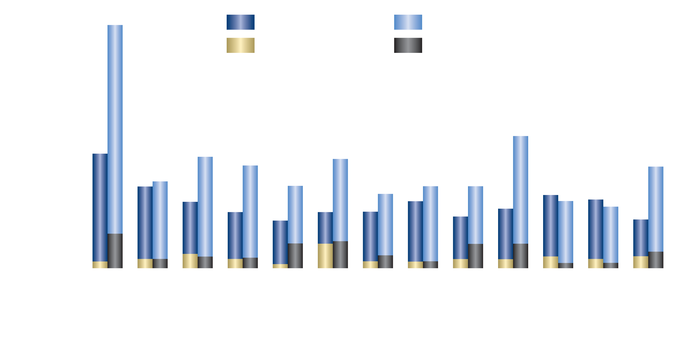
Neredovito krvarenje
Nuvaring vs KOK
Incidence of breakthrough bleeding or spotting
ªp<0.05 for NuvaRing® versus the pill for both breakthrough bleeding and spotting; ^{b}p<0.05 for NuvaRing® versus the pill for breakthrough spotting only
Milsom I, et al. Hum Reprod 2006;21(9):2304-2311
Notes:
Milsom et al compared the efficacy, acceptability and tolerability of NuvaRing (n=499) compared with Yasmin (n=484). Breakthrough bleeding or spotting during cycles 2-13 was less frequent in women taking NuvaRing (3.6-6.2%) compared with Yasmin (4.7-10.4%). The mean number of bleeding/spotting days in a single cycle ranged from 1.4-4.5 days over cycles 2-13 for NuvaRing and 1.8-3.3 days for Yasmin.
The incidence of cycles with irregular bleeding/spotting in women using NuvaRing® was compared with that in women using a COC containing 30 μg ethinyl EE and 150 μg LNG
The incidence of irregular bleeding with NuvaRing® was substantially lower than with 30 EE/150 LNG. The difference in the first cycle was partially due to the difference in starting days relative to the menstrual bleed of the two methods of contraception. Although this study only had enough power to show a statistical significance in the first cycle the data for each product are in line with those observed in their respective large non-comparative efficacy studies, thus suggesting less bleeding with NuvaRing® in the remaining cycles as well.
The most common reason patients discontinue COCs is abnormal bleeding. And most patients that do quit because of this reason do so in the very first month despite our efforts to counsel patients about this.

Slide 17
Kontrola ciklusa
Niska incidenca neredovitih krvarenja
Visoka incidenca željenog uzorka krvarenja
Niska stopa prekida zbog neredovitih krvarenja (0.8%)
Izvrsna kontrola ciklusa je vjerojatno posljedica kontinuiranog oslobađanja hormona iz prstena.
Dieben T, et al. Obstet and Gynecol 2002;100:585-593; Bjarnadóttir R, et al. Am J Obstet Gynecol 2002;186:(3)389-395
Notes:
The large efficacy studies and the comparative studies show that NuvaRing® use is associated with a very low incidence of irregular bleeding. Furthermore, the high incidence of intended bleeding pattern demonstrates that many cycles had what is considered to be ‘an ideal pattern of bleeding’ (intended bleeding pattern).
For any hormonal contraceptive, good cycle control is important because irregular bleeding is a common reason given for stopping the use of a particular method. With NuvaRing®, good cycle control was evidenced by the very low proportion of women withdrawing from studies because of bleeding irregularities (0.8%).
For many of the parameters examined, comparative studies show that the cycle control achieved using NuvaRing® is significantly better than that with a 30 μg ethinyl estradiol and 150 μg LNG combined oral contraceptive, even though NuvaRing® releases a lower dose of EE (15 μg) per day.
Dieben et al reported the combined data for two large trials conducted in Europe and North America that assessed the efficacy, cycle control, tolerability and acceptability of NuvaRing for up to 13 cycles. These were two open-label, non-comparative studies performed in Europe, Canada and the US. The ITT was 2322 women.
As previously discussed, Bjarnadottir et al compared data from three open-label, comparative trials on cycle control and tolerability of NuvaRing (n=121) with Microgynon 30 (COC; n=126) in women aged 18-40.

Slide 18
Kontracepcijska efikasnost
 | Pregnancies | Cycles (n) | Pearl Index | 95% confidence interval
Intent to treat (method failure and user failure) | 6 | 12,109 | 0.65 | 0.24–1.41
Per protocol population (method failure) | 3 | 9880 | 0.40 | 0.08–1.16
Roumen F. Eur J Contracept Reprod Health Care 2002;7(Suppl):19-24
Notes:
This study was one of two open-label studies using the same protocol that was conducted in Europe, the Middle East and North American, designed to evaluate the efficacy and tolerability of NuvaRing with 1 year of use. NuvaRing was used for 3 weeks followed by a 1 week ring free period.
Roumen et al, reported on the 1145 women from 52 centers in Europe and the Middle East (Austria, Belgium, Denmark, Finland, France, Germany, Israel, The Netherlands, Norway, Spain, Sweden and the UK). Dieben et al 2002 reported on the combined European and North American data.
The combined data from the European and North American NuvaRing® efficacy studies show that 21 in-treatment pregnancies occurred during the 23,298 cycles of NuvaRing® use. Consequently, the Pearl Index for all NuvaRing® users, the intent-to-treat population, was 1.18 (95% confidence interval [CI]: 0.73–1.80). Eleven of the 21 women who became pregnant appeared to have substantially violated compliance to NuvaRing® in the cycle of conception. Therefore, the Pearl Index for all women who followed the protocol correctly (the per protocol [PP] population), was 0.77 (95% CI: 0.26–1.21). (Dieben, et al 2002)

Slide 19
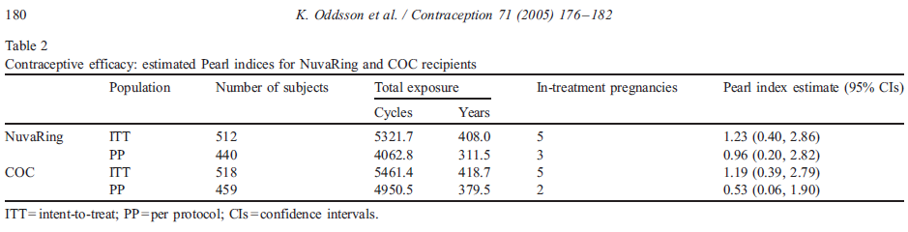
Kontracepcijska efikasnost

Slide 20
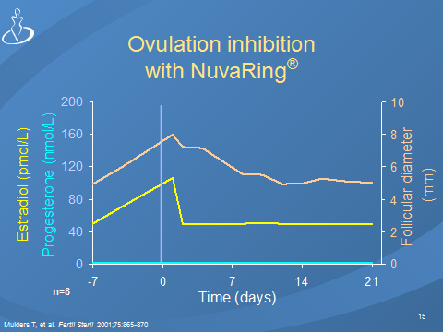

Slide 21
Nuspojave
Profil nuspojava prstena je sličan KOK!
Niža je incidenca mučnine¹ in napetih dojki ²!
Visoka incidenca vaginalnih simptoma.
1.Oddson K et al., Contraception 2005
2.Dieben TOM, Obste Gynecol 2002

Slide 22

Nuspojave, koje vode u prekid upotrebe kontracepcije
Nuspojave | NuvaRing N=58 | KOK N=45
Vezane uz prsten | 11
glavobolja | 4 | 8
leukoreja | 7
Porast tel. tiježine |  | 6
depresija | 4 | 3
nausea | 3 | 4
Vaginalni diskomfort | 3
Smanjen libido |  | 5
Notes:
In this large efficacy study, 15.1% of the women who started treatment discontinued the study because of adverse events. Most of the discontinuations occurred within the first 3 months. The most frequently reported adverse events leading to discontinuation from the study were device-related events (2.5%), headache (1.3%), vaginal discomfort (1.0%) and nausea (1.0%).
Only a few women discontinued the ring because of bleeding irregularities or vaginitis.

Slide 23
U mogim studijama analizirali su
kontracepcijsku efikasnost
kontrolu ciklusa
prihvatljivost
nuspojave
  NuvaRinga

Slide 24
Nekomparativne pretrage
Roumen FJME, Apter D, Mulders TMT et al. Efficacy, tolerability and acceptability of a novel vaginal ring releasing etonogestrel and ethynil oestradiol. Hum Reprod 2001; 16:469-75.
Dieben TOM, Roumen FJME, Apter D. Efficacy, cycle control and user acceptability of a novel combined contraceptive vaginal ring. Obstet Gynecol 2002; 100:585-93.
Novak A, de la Loge C, Abetz L, van der Meulen EA. The combined contraceptive vaginal ring, NuvaRing: an international study of user acceptability. Contraception 2003; 67(3):187-94.

Slide 25
  Većina žena bila je zadovoljna ili vrlo zadovojna s
  NuvaRingom
  Korisnice su ocijenile, da je NuvaRing jednostavno
  staviti u rodnicu
  Prisutnost vaginalnog prstena nije smetala većini žena i
  njihovim partnerima
  97% korisnica bi priporučilo NuvaRing drugim ženama
  Za NuvaRing continuation rate je 71.1% to 74.9%, za KOK 71.2–74.6%.
  Dieben et al. Obstet Gynecol 2002
Roumen FJ et al.. Hum Reprod 2001

Slide 26
Komparativne pretrage
Oddson K, Leifels Fisher B, de Melo NR et al. Efficacy and safety of a contraceptive vaginal ring (NuvaRing) compared with a combined oral contraceptive: a 1-year randomized trial. Contraception 2005a; 71:176-82.
Ahrendt HJ, Nisand I, Bastianelli C et al. Efficacy, acceptability and tolerabiity of the combined contraceptive ring, Nuvaring, compared with an oral contraceptive containing 30µg ethinyl estradiol and 3 mg of drospirenone. Contraception 2006; 74:451-7.
Schafer JE, Osborne LM, Davis AR et al. Acceptability and satisfaction using Quick Start with the contraceptive vaginal ring versus an oral contraceptive. Contraception 2006; 73:488-92.

Slide 27
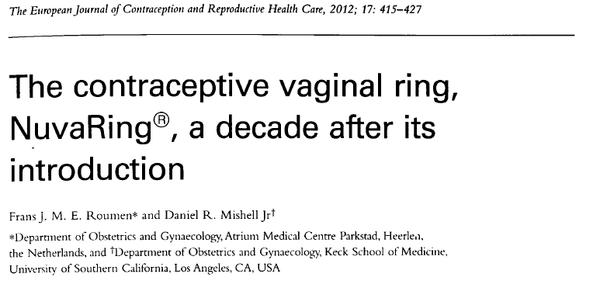

Slide 28


Isti mehanizem djelovanja, iste kontraindikacije kao kod KOK
Stabilnije koncentracije serumskih steroida, nižja razina estradiola u
serumu
Slična kontracepcijska efikasnost i metaboličke promjene kao kod KOK
Bolja kontrola ciklusa
Manje nuspojava vezanih uz razinu estradiola
Ekspulzija prstena u 4 do 20 %
Lokalni negativni učinci su glavni uzrok za prekid upotrebe (2 do 6%)
Roumen FJME, Mishell DR. 2012

Slide 29
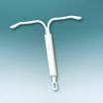



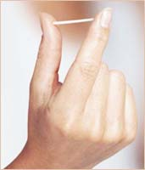


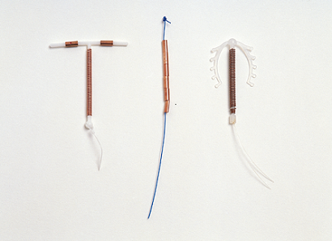
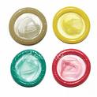

Novi kontraceptivi
  pitanja?
  entuzijazam!
  sumnje, zabrinutost..??

Slide 30





Klinička praksa
Pravilno savjetovanje i informiranje utjeću na prihvatljivost i zadovoljstvo korisnica kontracepcije!

Slide 31


Kakva je reakcija žena na novi način primjene kombinirane hormonske kontracepcije?
Većina žena pokazuje zanimanje..
One žele znati više..
Neke sumnjaju....što?
Agren U, 2009

Slide 32
Kakva je reakcija žena na novi način primjene kombinirane hormonske kontracepcije?
Mnoge žene pozdravljaju oblik hormonske
kontracepcije, koji je
prikladan in jednostavan
ne zahtijeva dnevni režim uzimanja
ne zahtijeva lječničku intervenciju
(stavljanje, uklanjanje IUD, implantata)
omogućuje ženama, da kontroliraju svoju metodu kontracepcije
Agren U, 2009

Slide 33


Prezentacija NuvaRinga
otvara pitanja..??
Agren U, 2009

Slide 34
Pitanja za ginekologa
Kako djeluje?
Da li je učinkovit?
Kako ga upotrebljavati? Da li trebam liječnika?
Gdje staviti prsten?
Kako rukovati sa prstenom?
Da li ću prsten osjećati, …..partner?
Moguča ekspulzija?
Veći rizik za kolpitis?......
Agren U, 2009

Slide 35
Klinička iskustva
Alternativni je oblik kombinirane hormonske kontracepcije
  Žene mogu odabrati najpovolniji oblik
Prikladni je oblik kontracepcije za žene, koje još ne upotrebljavaju kontracepciju (starters) i za one, koje žele promjeniti oblik zaštite (switchers).
Agren U, 2009

Slide 36



Klinička iskustva
Mlađe žene su "moderne"
Većina žena nema negativnu sliku o svojoj rodnici
Postoji manja skupina žena, koje ne žele mogučnost vaginalne administracije
Agren U, 2009

Slide 37
Klinička iskustva
Postoji manja grupa žena, koja će uvijek osjećati prsten u rodnici!
    1-2% žena
    Anatomija?
    Ako osjećaj ne prestaje kad se pomiče prsten više u rodnicu, bolje je promijeniti metodu kontracepcije!
Agren U, 2009

Slide 38
Klinička iskustva
Prikladno za žene
  s glavoboljom
  s gastrointestinalnim problemima
  s dismenorejom
  koje zaborave uzeti tabletu
  za mame s malom djecom
  koje rade u smjenama
  za studentice
  koje puno putuju
  Agren U, 2009

Slide 39
Prednosti – vidik korisnica
Stavljanje i uklanjanje samo 1X mjesečno
Najniža doza EE, a dobra kontrola menstrualnog ciklusa
Neutralni učinak na tjelesnu težinu
Malo nuspojava
Agren U, 2009

Slide 40
Prednosti – vidik ginekologa
Visoka prihvatljivost i zadovoljstvo korisnica
Malo povratnica zbog nuspojava i problema
Veći izbor kontracepcije
Nešto novo
Alternativni oblik kombinirane hormonske kontracepcije
Agren U, 2009

Slide 41

Hvala na pažnji!

